Slide 1
Constrained least squares
applications
20170524 S.J. Hahn

Slide 2
Contents
Portfolio Optimization
Single asset investment
Portfolio investment
Portfolio optimization

Slide 3
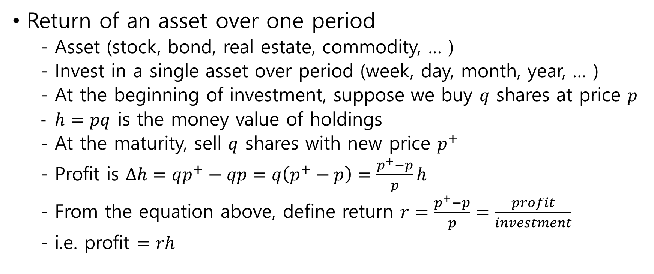
Single asset investment
Return of an asset over one period
Asset (stock, bond, real estate, commodity, … )
Invest in a single asset over period (week, day, month, year, … )
At the beginning of investment, suppose we buy $q$ shares at price $p$
$h=pq$ is the money value of holdings
At the maturity, sell $q$ shares with new price $p^{+}$
Profit is $Δh=qp^{+}−qp=q\left(p^{+}−p\right)=\frac{p^{+}−p}{p}h$
From the equation above, define return $r=\frac{p^{+}−p}{p}=\frac{profit}{investment}$
i.e. profit $=rh$

Slide 4
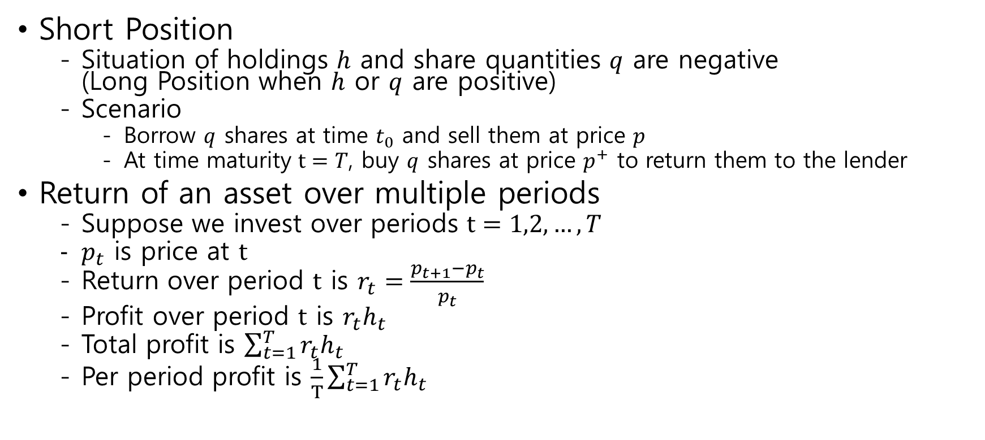
Single asset investment
Short Position
Situation of holdings $h$ and share quantities $q$ are negative (Long Position when $h$ or $q$ are positive)
Scenario
Borrow $q$ shares at time $t_{0}$ and sell them at price $p$
At time maturity $t=T$, buy $q$ shares at price $p^{+}$ to return them to the lender
Return of an asset over multiple periods
Suppose we invest over periods $t=1,2,…,T$
$p_{t}$ is price at $t$
Return over period $t$ is $r_{t}=\frac{p_{t+1}−p_{t}}{p_{t}}$
Profit over period $t$ is $r_{t}h_{t}$
Total profit is $\sum_{t=1}^{T}{r_{t}h_{t}}$
Per period profit is $\frac{1}{T}\sum_{t=1}^{T}{r_{t}h_{t}}$

Slide 5
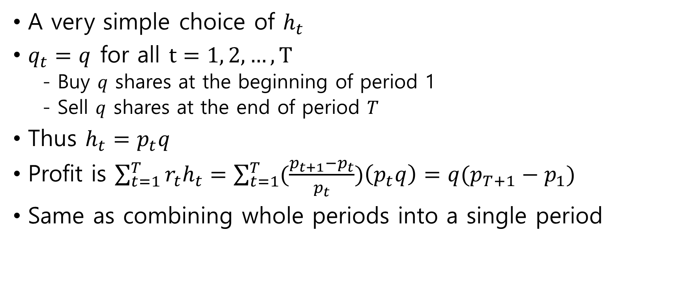
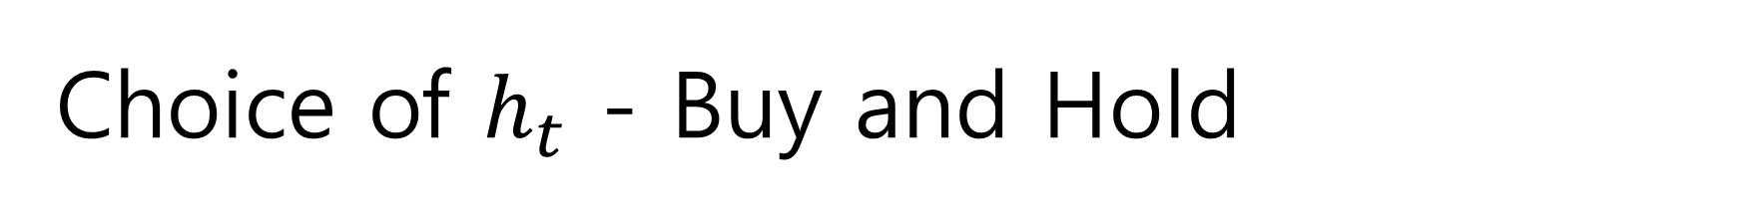
Choice of $h_{t}$ - Buy and Hold
A very simple choice of $h_{t}$
$q_{t}=q$ for all $t=1, 2, …, T$
Buy $q$ shares at the beginning of period 1
Sell $q$ shares at the end of period $T$
Thus $h_{t}=p_{t}q$
Profit is $\sum_{t=1}^{T}{r_{t}h_{t}}=\sum_{t=1}^{T}{(\frac{p_{t+1}−p_{t}}{p_{t}}})\left(p_{t}q\right)=q(p_{T+1}−p_{1})$
Same as combining whole periods into a single period

Slide 6
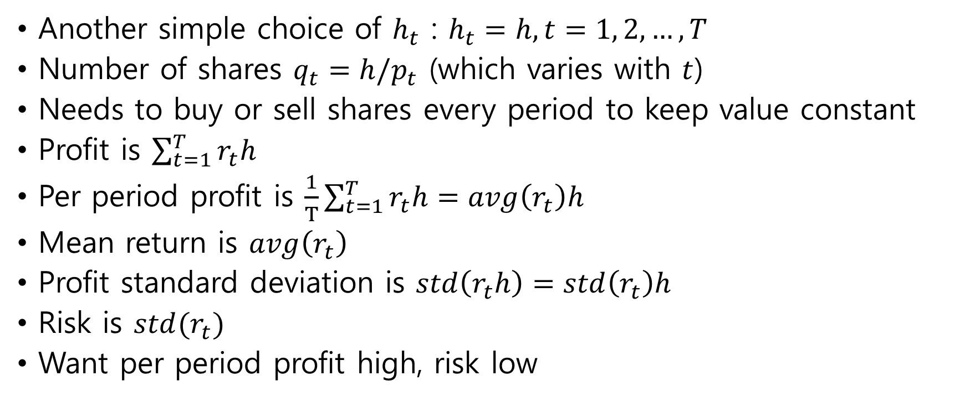
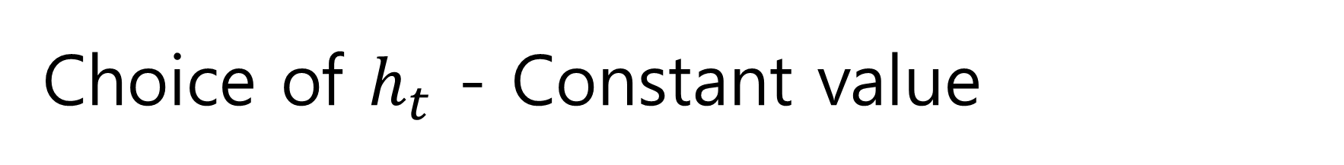
Choice of $h_{t}$ - Constant value
Another simple choice of $h_{t}$ : $h_{t}=h, t=1, 2, …, T$
Number of shares $q_{t}=h/p_{t}$ (which varies with $t$)
Needs to buy or sell shares every period to keep value constant
Profit is $\sum_{t=1}^{T}{r_{t}h}$
Per period profit is $\frac{1}{T}\sum_{t=1}^{T}{r_{t}h}=avg\left(r_{t}\right)h$
Mean return is $avg\left(r_{t}\right)$
Profit standard deviation is $std\left(r_{t}h\right)=std\left(r_{t}\right)h$
Risk is $std(r_{t})$
Want per period profit high, risk low

Slide 7

Annualizing Return and Risk
Mean return and risk are often expressed in annualized form
If there are P trading periods per year
Annualized return = $Pavg\left(r_{t}\right)$
Annualized risk = $\sqrt{P}std\left(r_{t}\right)$

Slide 8
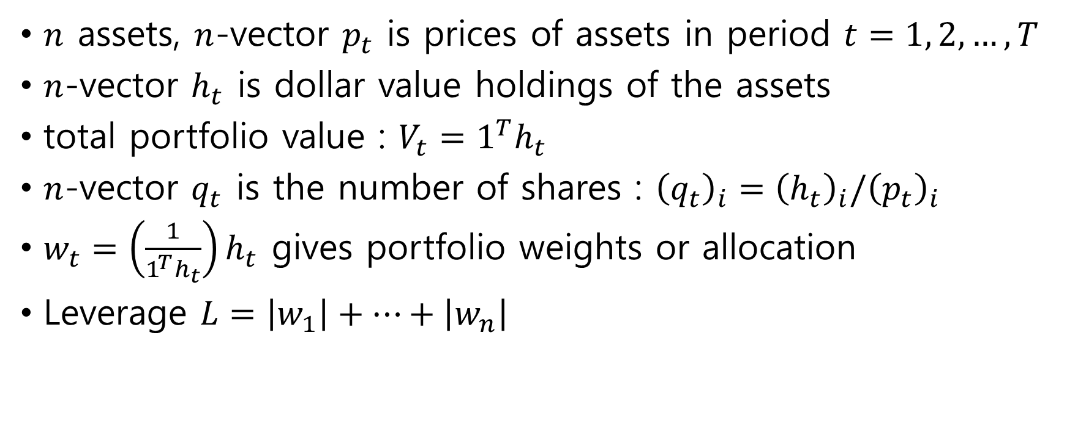
Portfolio of assets
$n$ assets, $n$-vector $p_{t}$ is prices of assets in period $t=1, 2, …, T$
$n$-vector $h_{t}$ is dollar value holdings of the assets
total portfolio value : $V_{t}=1^{T}h_{t}$
$n$-vector $q_{t}$ is the number of shares : ${\left(q_{t}\right)}_{i}={\left(h_{t}\right)}_{i}/{\left(p_{t}\right)}_{i}$
$w_{t}=\left(\frac{1}{1^{T}h_{t}}\right)h_{t}$ gives portfolio weights or allocation
Leverage $L=\left|w_{1}\right|+…+\left|w_{n}\right|$

Slide 9
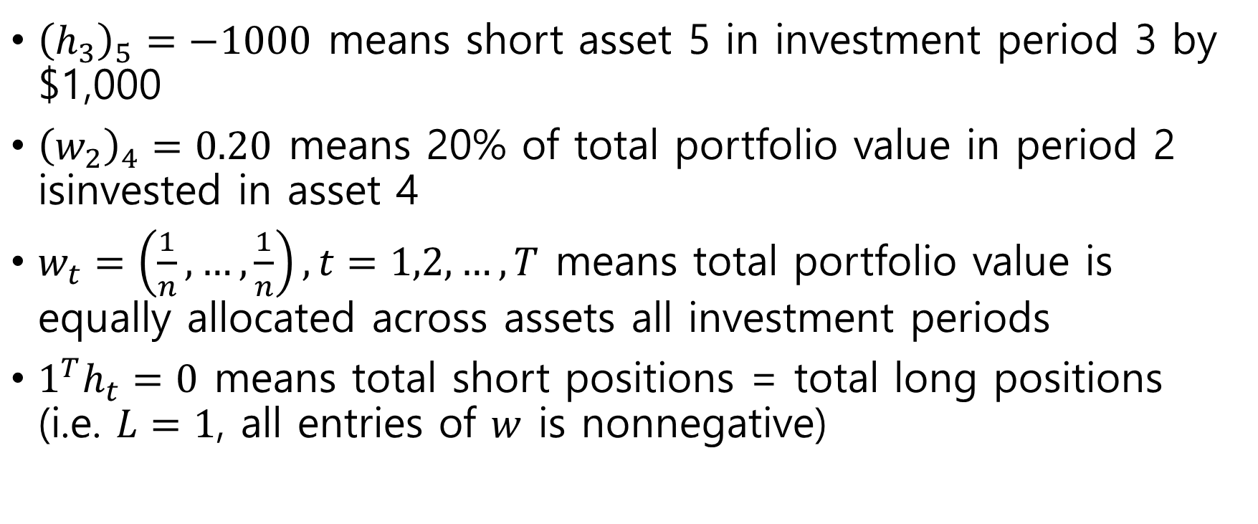
Examples
${\left(h_{3}\right)}_{5}=−1000$ means short asset 5 in investment period 3 by $1,000
${\left(w_{2}\right)}_{4}=0.20$ means 20% of total portfolio value in period 2 isinvested in asset 4
$w_{t}=\left(\frac{1}{n}, …,\frac{1}{n}\right), t=1,2, …, T$ means total portfolio value is equally allocated across assets all investment periods
$1^{T}h_{t}=0$ means total short positions = total long positions (i.e. $L=1$, all entries of $w$ is nonnegative)

Slide 10
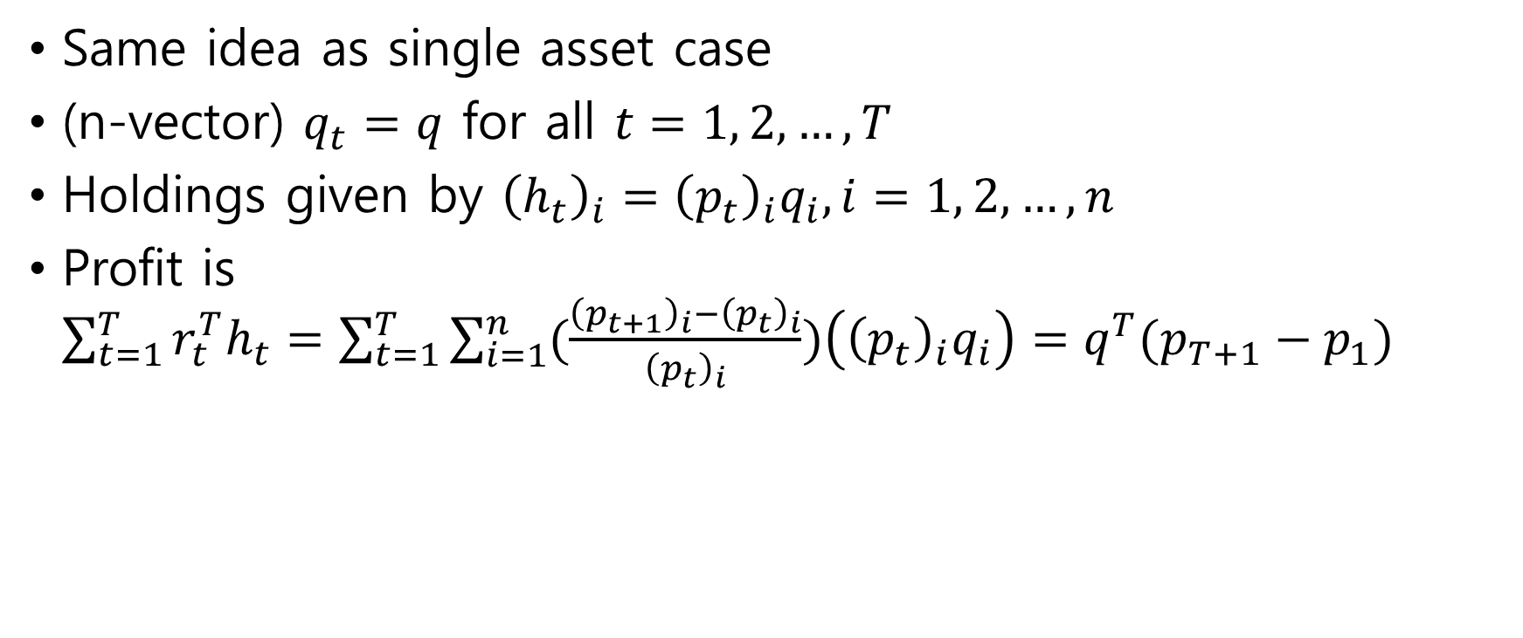
Buy and hold portfolio
Same idea as single asset case
(n-vector) $q_{t}=q$ for all $t=1, 2, …, T$
Holdings given by ${\left(h_{t}\right)}_{i}={\left(p_{t}\right)}_{i}q_{i}, i=1, 2, …, n$
Profit is $\sum_{t=1}^{T}{r_{t}^{T}h_{t}=\sum_{t=1}^{T}{\sum_{i=1}^{n}{(\frac{{\left(p_{t+1}\right)}_{i}−{\left(p_{t}\right)}_{i}}{{\left(p_{t}\right)}_{i}}})\left({\left(p_{t}\right)}_{i}q_{i}\right)=q^{T}(p_{T+1}−p_{1})}}$

Slide 11
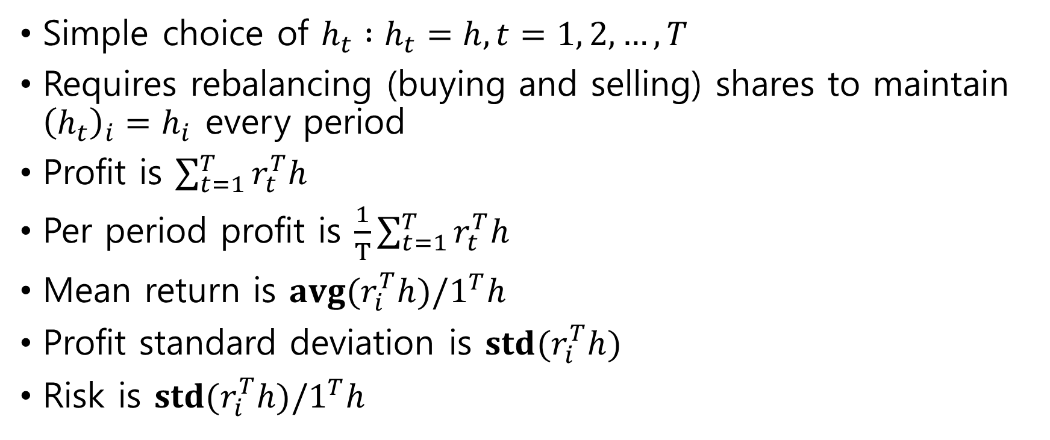
Constant value portfolio
Simple choice of $h_{t} :h_{t}=h, t=1, 2, …, T$
Requires rebalancing (buying and selling) shares to maintain ${\left(h_{t}\right)}_{i}=h_{i}$ every period
Profit is $\sum_{t=1}^{T}{r_{t}^{T}h}$
Per period profit is $\frac{1}{T}\sum_{t=1}^{T}{r_{t}^{T}h}$
Mean return is $avg(r_{i}^{T}h)/1^{T}h$
Profit standard deviation is $std(r_{i}^{T}h)$
Risk is $std(r_{i}^{T}h)/1^{T}h$

Slide 12
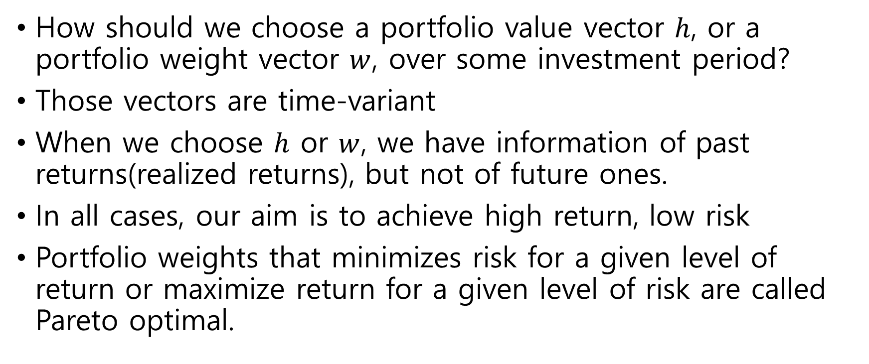
Portfolio Optimization
How should we choose a portfolio value vector $h$, or a portfolio weight vector $w$, over some investment period?
Those vectors are time-variant
When we choose $h$ or $w$, we have information of past returns(realized returns), but not of future ones.
In all cases, our aim is to achieve high return, low risk
Portfolio weights that minimizes risk for a given level of return or maximize return for a given level of risk are called Pareto optimal.

Slide 13
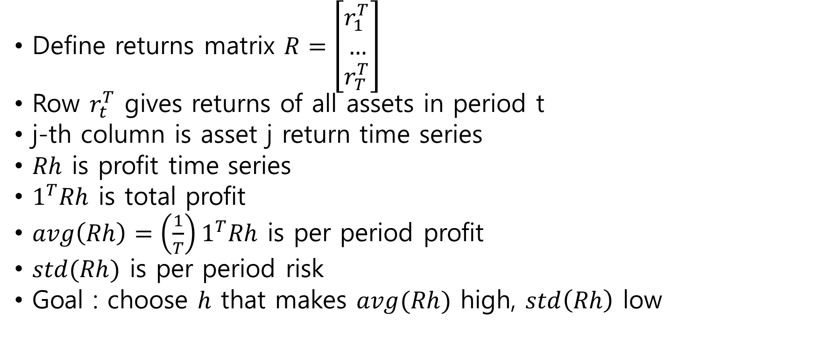
Portfolio Optimization (cont’d)
Define returns matrix $R=\left[\begin{aligned}r_{1}^{T} \\ … \\ r_{T}^{T}\end{aligned}\right]$
Row $r_{t}^{T}$ gives returns of all assets in period t
j-th column is asset j return time series
$Rh$ is profit time series
$1^{T}Rh$ is total profit
$avg\left(Rh\right)=\left(\frac{1}{T}\right)1^{T}Rh$ is per period profit
$std(Rh)$ is per period risk
Goal : choose $h$ that makes $avg(Rh)$ high, $std\left(Rh\right)$ low

Slide 14
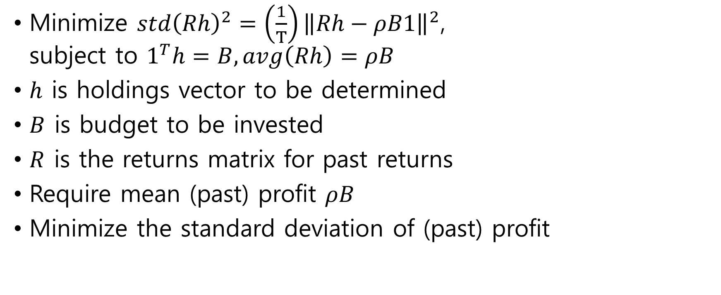
Portfolio Optimization via LS on past returns
Minimize $std{\left(Rh\right)}^{2}=\left(\frac{1}{T}\right){\left\|Rh−ρB1\right\|}^{2}$, subject to $1^{T}h=B, avg\left(Rh\right)=ρB$
$h$ is holdings vector to be determined
$B$ is budget to be invested
$R$ is the returns matrix for past returns
Require mean (past) profit $ρB$
Minimize the standard deviation of (past) profit

Slide 15
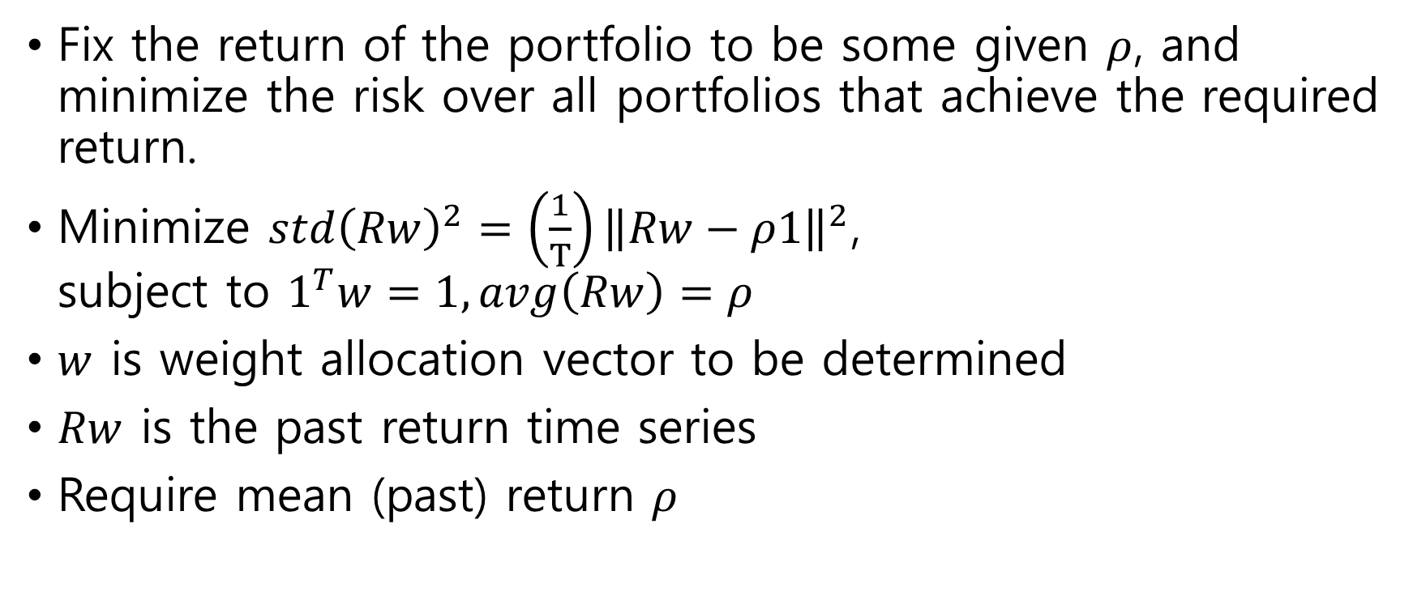
Constant weight Portfolio Optimization
Fix the return of the portfolio to be some given $ρ$, and minimize the risk over all portfolios that achieve the required return.
Minimize $std{\left(Rw\right)}^{2}=\left(\frac{1}{T}\right){\left\|Rw−ρ1\right\|}^{2}$, subject to $1^{T}w=1, avg\left(Rw\right)=ρ$
$w$ is weight allocation vector to be determined
$Rw$ is the past return time series
Require mean (past) return $ρ$

Slide 16
Optimal Portfolio
The portfolio optimization problem has solution (two-funded theorem)

Slide 17
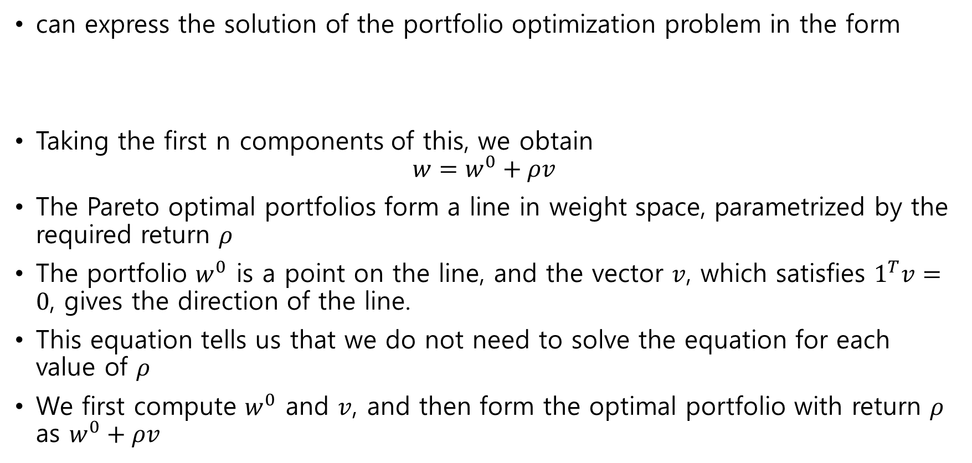
Two-funded theorem
can express the solution of the portfolio optimization problem in the form
Taking the first n components of this, we obtain $w=w^{0}+ρv$
The Pareto optimal portfolios form a line in weight space, parametrized by the required return $ρ$
The portfolio $w^{0}$ is a point on the line, and the vector $v$, which satisfies $1^{T}v=0$, gives the direction of the line.
This equation tells us that we do not need to solve the equation for each value of $ρ$
We first compute $w^{0}$ and $v$, and then form the optimal portfolio with return $ρ$ as $w^{0}+ρv$

Slide 18
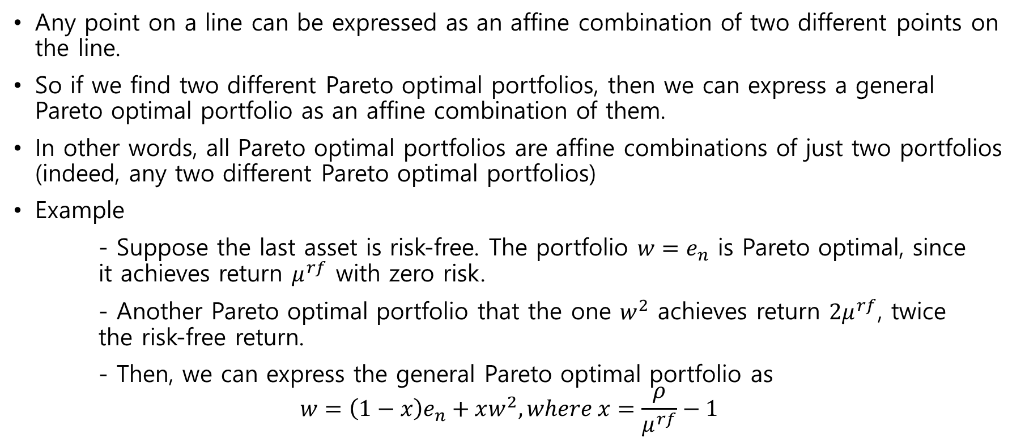
Two-funded theorem (cont’d)
Any point on a line can be expressed as an affine combination of two different points on the line.
So if we find two different Pareto optimal portfolios, then we can express a general Pareto optimal portfolio as an affine combination of them.
In other words, all Pareto optimal portfolios are affine combinations of just two portfolios (indeed, any two different Pareto optimal portfolios)
Example
- Suppose the last asset is risk-free. The portfolio $w=e_{n}$ is Pareto optimal, since it achieves return $μ^{rf}$ with zero risk.
- Another Pareto optimal portfolio that the one $w^{2}$ achieves return $2μ^{rf}$, twice the risk-free return.
- Then, we can express the general Pareto optimal portfolio as $$w=\left(1−x\right)e_{n}+xw^{2}, where x=\frac{ρ}{μ^{rf}}−1$$

Slide 19
The big assumption
The big assumption (BA) :
future returns will look something like past ones
- warned this is false, every time we invest
- it is often reasonably true
- in periods of ‘market shift’ it’s much less true
- often can be in a trap of over-fitting
if BA holds (even approximately), then a good weight vector for past (realized) returns should be good for future (unknown) returns

Slide 20
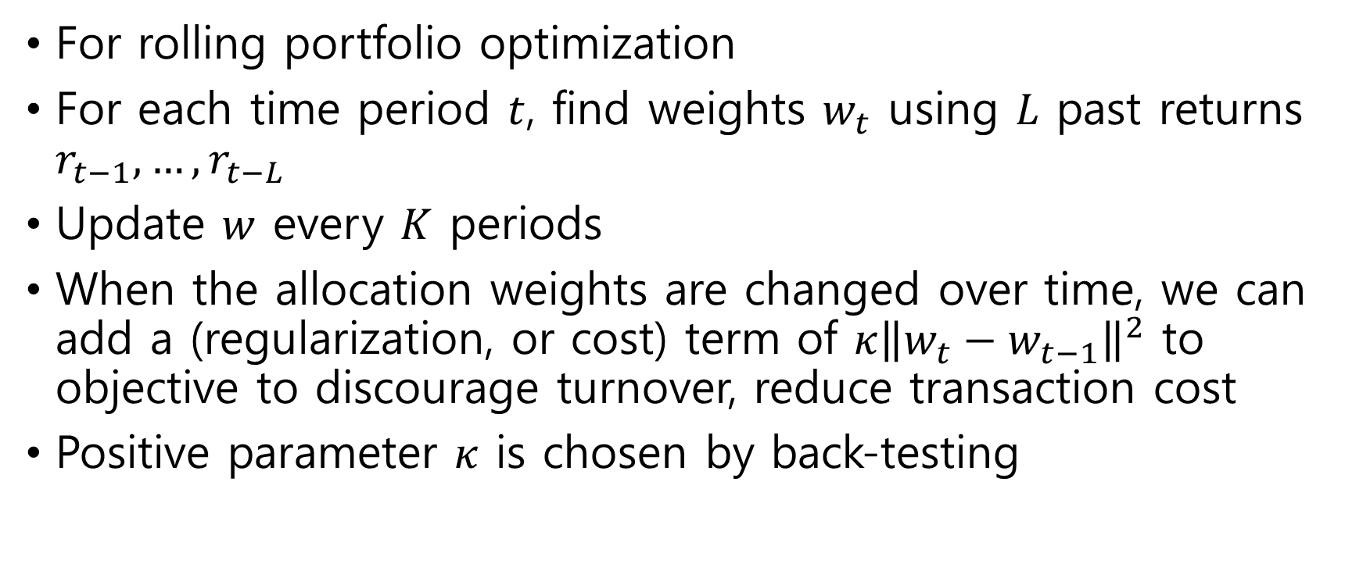
Time-varying weights
For rolling portfolio optimization
For each time period $t$, find weights $w_{t}$ using $L$ past returns $r_{t−1}, …, r_{t−L}$
Update $w$ every $K$ periods
When the allocation weights are changed over time, we can add a (regularization, or cost) term of $κ{\left\|w_{t}−w_{t−1}\right\|}^{2}$ to objective to discourage turnover, reduce transaction cost
Positive parameter $κ$ is chosen by back-testing

Slide 21
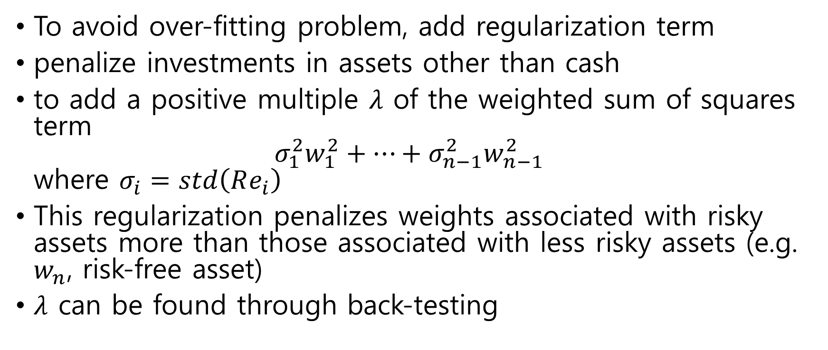
Regularization
To avoid over-fitting problem, add regularization term
penalize investments in assets other than cash
to add a positive multiple $λ$ of the weighted sum of squares term $σ_{1}^{2}w_{1}^{2}+…+σ_{n−1}^{2}w_{n−1}^{2}$ where $σ_{i}=std\left(Re_{i}\right)$
This regularization penalizes weights associated with risky assets more than those associated with less risky assets (e.g. $w_{n}$, risk-free asset)
$λ$ can be found through back-testing

